Slide 1
CS305
System Modeling and Simulation
Prof. Dr. Khaled Mahar
khmahar@aast.edu
Lecture 8

Slide 2
Chapter 9 Input Modeling
Banks, Carson, Nelson & Nicol
Discrete-Event System Simulation

Slide 3
Purpose & Overview
Input models provide the driving force for a simulation model.
The quality of the output is no better than the quality of inputs.
In this chapter, we will discuss the 4 steps of input model development:
Collect data from the real system
Identify a probability distribution to represent the input process
Choose parameters for the distribution
Evaluate the chosen distribution and parameters for goodness of fit.

Slide 4
Data Collection
Suggestions that may enhance and facilitate data collection:
Plan ahead: begin by a practice or pre-observing session, watch for unusual circumstances
Analyze the data as it is being collected: check adequacy
Combine homogeneous data sets, e.g. successive time periods, during the same time period on successive days
Be aware of data censoring: the quantity is not observed in its entirety, danger of leaving out long process times
Check for relationship between variables, e.g. build scatter diagram
Check for autocorrelation
Collect input data, not performance data

Slide 5
Data Collection
To illustrate data collection activities, consider modeling a painting station, where
jobs arrive at random, wait in the buffer until the sprayer is available
having been sprayed, they leave the station
suppose that the spray nozzle can get blocked – an event that results in a stoppage during which the nozzle is cleaned or replaced.
suppose further that the measure of interest is the expected job delay in the buffer.
The data collected in this simple case would consist of:
collection of job inter-arrival times
collection of painting times
collection of times between nozzle blockage
collection of nozzle cleaning/replacement times

Slide 6
Identifying the Distribution
Histograms
Selecting families of distribution
Parameter estimation
Goodness-of-fit tests
Fitting a non-stationary process

Slide 7
Histograms [Identifying the distribution]
A frequency distribution or histogram is useful in determining the shape of a distribution
Divide the range of data into intervals.
(Usually of equal length)
Label the horizontal axis to conform to the intervals selected.
Find the frequency of occurrences within each interval.
Label the vertical axis so that the total occurrences can be plotted for each interval.
Plot the frequencies on the vertical axis.

Slide 8
Histograms continued
The number of class intervals depends on:
The number of observations
The dispersion of the data
Suggested: No. of interval = the square root of the sample size
For continuous data:
Corresponds to the probability density function of a theoretical distribution
For discrete data:
Corresponds to the probability mass function
If few data points are available: combine adjacent cells to eliminate the ragged appearance of the histogram

Slide 9
Sample Histograms
Ragged, Coarse, and appropriate histogram
(1) Original Data - Too ragged
Notes:
30

Slide 10
Sample Histograms (cont.)
Ragged, Coarse, and appropriate histogram
(2) Combining adjacent cells - too coarse
Notes:
30

Slide 11
Sample Histograms (cont.)
Ragged, Coarse, and appropriate histogram
(3) Combining adjacent cells - appropriate
Notes:
30

Slide 12
Discrete Data Example
The number of vehicles arriving at an intersection in a 5-minute period between 7:00 a.m. and 7:05 a.m. was monitored for five workdays over a 20-week period.
Arrivals/period Frequency | Arrivals/period Frequency
0 12 1 10 2 19 3 17 4 10 5 8 | 6 7 7 5 8 5 9 3 10 3 11 1
Notes:
30

Slide 13
Discrete Data Example (cont.)
Arrivals/period Frequency | Arrivals/period Frequency
0 12 1 10 2 19 3 17 4 10 5 8 | 6 7 7 5 8 5 9 3 10 3 11 1
The first entry in the table indicates that there were 12 5-minute periods during which zero vehicles arrived, 10 periods during which one vehicle arrived, and so on.
The resulting histogram is shown in next slide
Notes:
30

Slide 14
Histogram of number of arrivals per period
Number of arrivals per period
Since the data is discrete and there are ample data, so the histogram may have a cell for each possible value in the data range
Notes:
30

Slide 15
Continuous Data Example
Life tests were performed on a random sample of 50 electronic chips at 1.5 times the normal voltage, and their lifetime (or time to failure) in days was recorded:
79.919 3.081 0.062 1.961 5.845 3.027 6.505 0.021 0.012 0.123
6.769 59.899 1.192 34.760 5.009 18.387 0.141 43.565 24.420 0.433
144.695 2.663 17.967 0.091 9.003 0.941 0.878 3.371 2.157 7.579
0.624 5.380 3.148 7.078 23.960 0.590 1.928 0.300 0.002 0.543
7.004 31.764 1.005 1.147 0.219 3.217 14.382 1.008 2.336 4.562
Notes:
30

Slide 16
Continuous Data Example (cont.)
Chip Life (Days) Frequency Chip Life (Days) Frequency
0 ≤ x_{i} < 3 23 30 ≤ x_{i} < 33 1
3 ≤ x_{i} < 6 10 33 ≤ x_{i} < 36 1
6 ≤ x_{i} < 9 5 .......... .....
9 ≤ x_{i} < 12 1 42 ≤ x_{i} < 45 1
12 ≤ x_{i} < 15 1 .......... .....
15 ≤ x_{i} < 18 2 57 ≤ x_{i} < 60 1
18 ≤ x_{i} < 21 0 .......... .....
21 ≤ x_{i} < 24 1 78 ≤ x_{i} < 81 1
24 ≤ x_{i} < 27 1 .......... .....
27 ≤ x_{i} < 30 0 143 ≤ x_{i} < 147 1
Electronic Chip Data
Notes:
30

Slide 17
Continuous Data Example (cont.)
Histogram of chip life
Notes:
30

Slide 18
Selecting the Family of Distributions [Identifying the distribution]
A family of distributions is selected based on:
The context of the input variable
The physical characteristics of the input process
Is it naturally discrete or continuous valued?
Are the observable values inherently bounded or is there no natural bound?
Shape of the histogram
There is no “true” distribution for any stochastic input process
Goal: obtain a good approximation

Slide 19
Selecting the Family of Distributions [Identifying the distribution]
Page 364: Use the physical basis of the distribution as a guide, for example:
Binomial: # of successes in n trials
Poisson: # of independent events that occur in a fixed amount of time or space
Normal: distribution of a process that is the sum of a number of component processes (time to assemble a product is the sum of times required fro each assembly operation)
Exponential: time between independent events, or a process time that is memoryless
Weibull: time to failure for components
Discrete or continuous uniform: models complete uncertainty
Triangular: a process for which only the minimum, most likely, and maximum values are known.

Slide 20
Quantile-Quantile Plots [Identifying the distribution]
Q-Q plot is a useful visual tool for evaluating the fit of the chosen distribution. These are not formal tests, but provide a quick tool to check if a certain distributional assumption is somewhat reasonable.
A q-q plot is a plot of the quantiles of a sample data set against the quantiles of chosen distribution. By a quantile, we mean the fraction (or percent) of points below the given value. That is, the 0.3 (or 30%) quantile is the point at which 30% percent of the data fall below and 70% fall above that value.
A 45-degree reference line is also plotted. If the two sets have the same distribution, the points should fall approximately along this reference line.

Slide 21
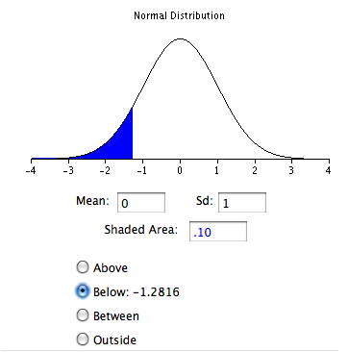
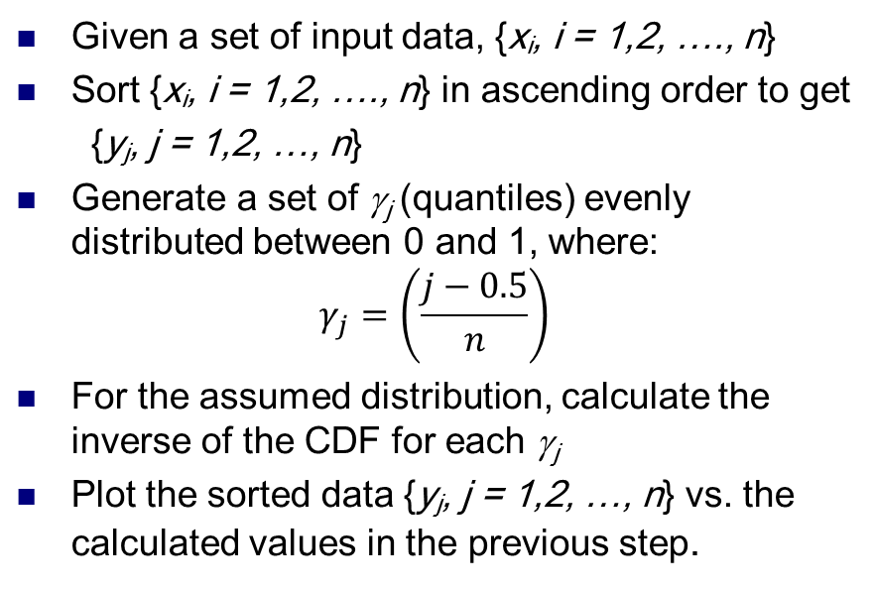
Quantile-Quantile Plots [Identifying the distribution]
Given a set of input data, {x_{i}, i = 1,2, …., n}
Sort {x_{i}, i = 1,2, …., n} in ascending order to get
{y_{j}, j = 1,2, …, n}
Generate a set of γ_{j} (quantiles) evenly distributed between 0 and 1, where:
$$γ_{j}=\left(\frac{j−0.5}{n}\right)$$
For the assumed distribution, calculate the inverse of the CDF for each γ_{j}
Plot the sorted data {y_{j}, j = 1,2, …, n} vs. the calculated values in the previous step.
x_{i} | Rank j | γ_{j} | N(0,1)
-1.96 | 1 | 0.1 | -1.28
-.78 | 2 | 0.3 | -0.52
0.31 | 3 | 0.5 | 0.00
1.15 | 4 | 0.7 | 0.52
1.62 | 5 | 0.9 | 1.28
Denote the CDF of N(0,1) as Φ, and consider the first ordered value, y₁. What might we expect the value of Φ(y₁) to be? Intuitively, we expect this probability to take on a value in the interval (0, 1/n). Likewise, we expect Φ(y₂) to take on a value in the interval (1/n, 2/n) and so on.

Slide 22
Quantile-Quantile Plots [Identifying the distribution]
Q-Q plot is a useful tool for evaluating the fit of the chosen distribution
If X is a random variable with cdf F, then the q-quantile of X is the γ such that
When F has an inverse, γ = F⁻¹(q)
Let {x_{i}, i = 1,2, …., n} be a sample of data from X and {y_{j}, j = 1,2, …, n} be the observations in ascending order:
where j is the ranking or order number

Slide 23
Quantile-Quantile Plots [Identifying the distribution]
Example: Check whether the door installation times follows a normal distribution.
The observations are now ordered from smallest to largest:
y_{j} are plotted versus F⁻¹( (j-0.5)/n) where F is the CDF of a normal distribution with the sample mean (99.99 sec) and sample variance (0.2832²)

Slide 24
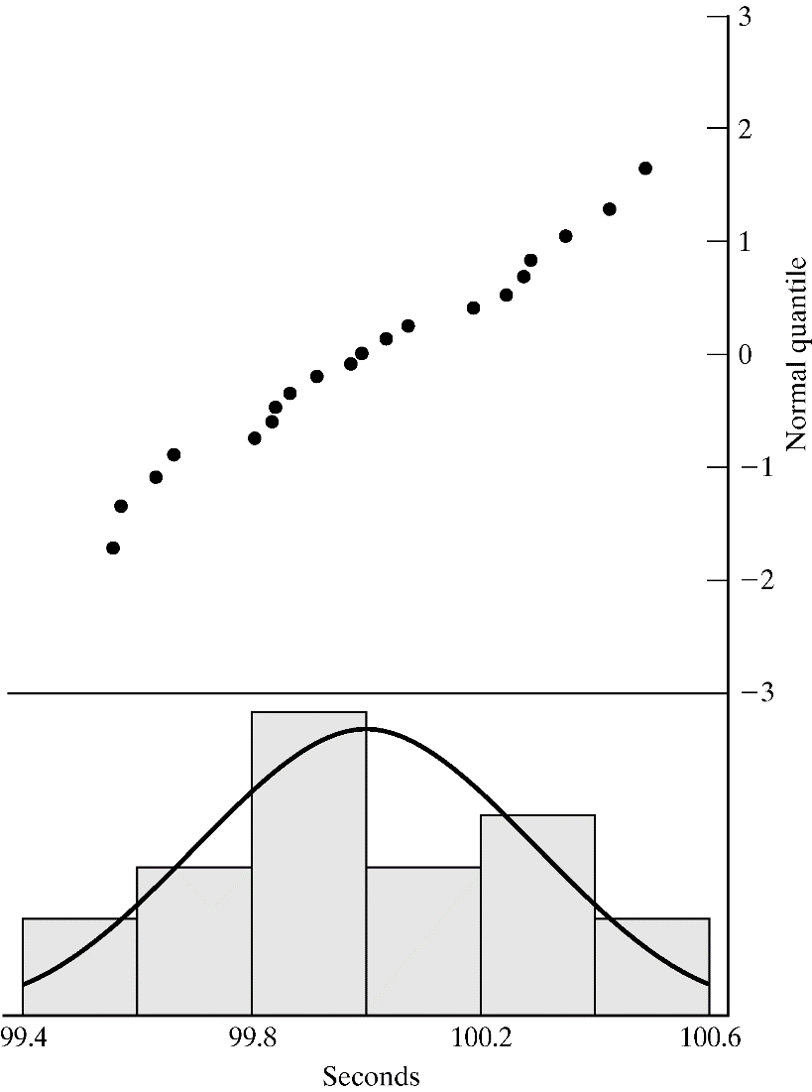
Quantile-Quantile Plots [Identifying the distribution]
Example (continued): Check whether the door installation times follow a normal distribution.
Straight line, supporting the hypothesis of a normal distribution
Superimposed density function of the normal distribution

Slide 25
Quantile-Quantile Plots [Identifying the distribution]
Consider the following while evaluating the linearity of a q-q plot:
The observed values never fall exactly on a straight line
The ordered values are ranked and hence not independent, unlikely for the points to be scattered about the line
Variance of the extremes is higher than the middle. Linearity of the points in the middle of the plot is more important.
Q-Q plot can also be used to check homogeneity
Check whether a single distribution can represent both sample sets
Plotting the order values of the two data samples against each other

Slide 26
Parameter Estimation [Identifying the distribution]
This is the next step after selecting a family of distributions
If observations in a sample of size n are X₁, X₂, …, X_{n} (discrete or continuous), the sample mean and variance are:
If the data are discrete and have been grouped in a frequency distribution:
where f_{j} is the observed frequency of value X_{j}

Slide 27
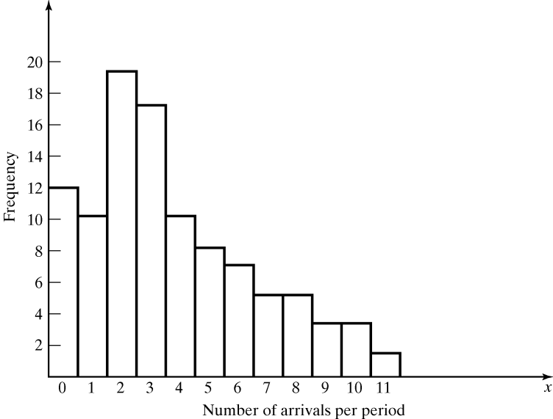
Parameter Estimation [Identifying the distribution]
Vehicle Arrival Example (continued): Table in the histogram example on slide 12(Table 9.1 in book) can be analyzed to obtain:
The sample mean and variance are
The histogram suggests X to have a Poisson distribution
However, note that sample mean is not equal to sample variance.
Reason: each estimator is a random variable, is not perfect.

Slide 28
Parameter Estimation [Identifying the distribution]
The Maximal-likelihood Estimation (MLE) method assumes a particular class of distributions (e.g., normal, uniform, exponential, etc.), and then estimates their parameters from the sample, such that the resulting parameters give rise to the maximal likelihood (highest probability or density) of obtaining the sample.
Example: Suppose that a random sample of size n, x₁,x₂,…,x_{n} has been taken and that the samples are assumed to come from an exponential distribution. Use the MLE method to estimate the distribution parameter.

Slide 29
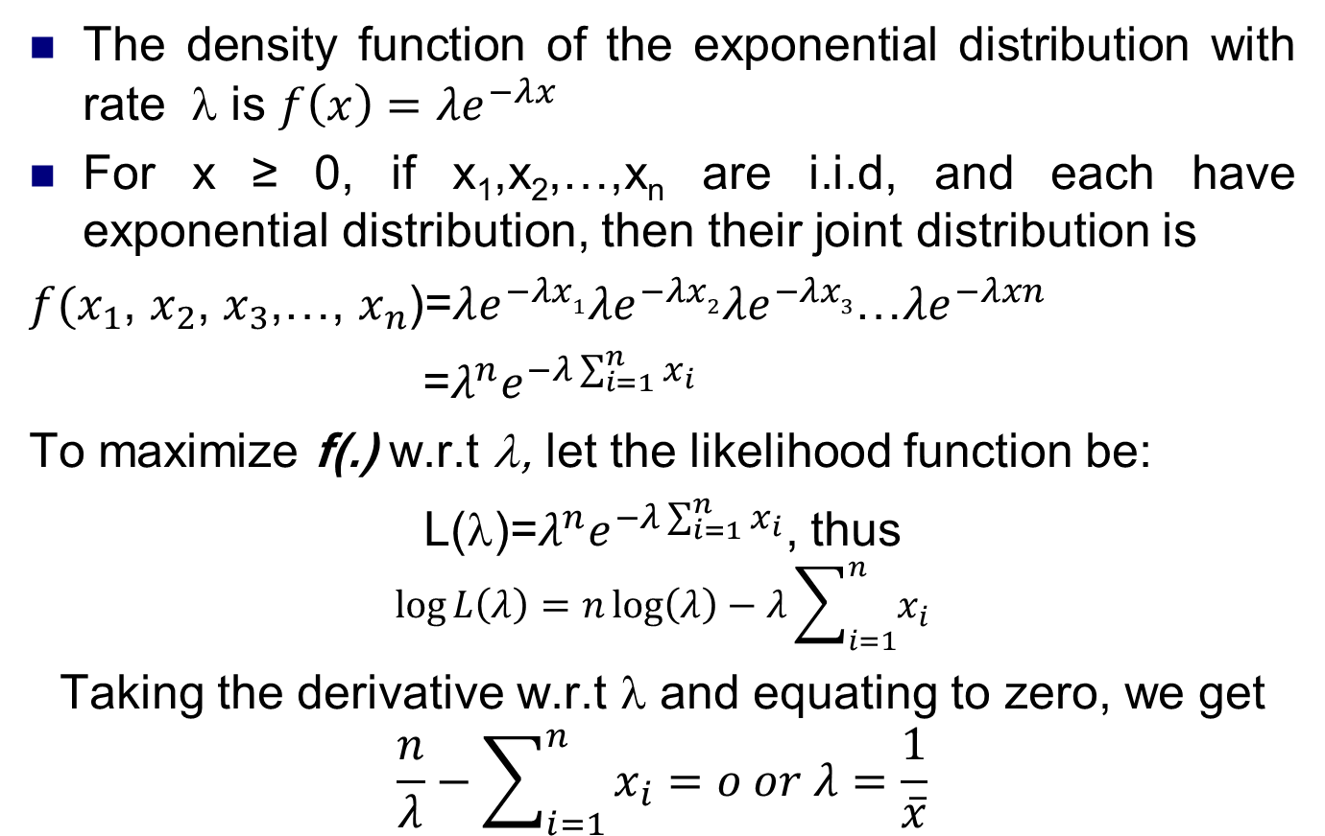
Maximum Likelihood Method [Identifying the distribution]
The density function of the exponential distribution with rate λ is $f\left(x\right)=λe^{−λx}$
For x ≥ 0, if x₁,x₂,…,x_{n} are i.i.d, and each have exponential distribution, then their joint distribution is
$f(x_{1}$, $x_{2}$, $x_{3}$,…, $x_{n}$)=$λe^{−λx1}λe^{−λx2}λe^{−λx3}$…$λe^{−λxn}$
=$λ^{n}e^{−λ\sum_{i=1}^{n}{x_{i}}}$
To maximize f(.) w.r.t λ, let the likelihood function be:
L(λ)=$λ^{n}e^{−λ\sum_{i=1}^{n}{x_{i}}}$, thus
$$\log{L\left(λ\right)=n\log\left(λ\right)−λ\sum_{i=1}^{n}{x_{i}}}$$
Taking the derivative w.r.t λ and equating to zero, we get
$$\frac{n}{λ}−\sum_{i=1}^{n}{x_{i}=o or λ=\frac{1}{\overline{x}}}$$

Slide 30
Goodness-of-Fit Tests [Identifying the distribution]
Conduct hypothesis testing on input data distribution using:
Kolmogorov-Smirnov test
Chi-square test
No single correct distribution in a real application exists.
If very little data are available, it is unlikely to reject any candidate distributions
If a lot of data are available, it is likely to reject all candidate distributions

Slide 31
Chi-Square test [Goodness-of-Fit Tests]
Intuition: comparing the histogram of the data to the shape of the candidate density or mass function
Valid for large sample sizes when parameters are estimated by maximum likelihood
By arranging the n observations into a set of k class intervals or cells, the test statistics is:
which approximately follows the chi-square distribution with k-s-1 degrees of freedom, where s = # of parameters of the hypothesized distribution estimated by the sample statistics.
Expected Frequency
E_{i} = n*p_{i}
where p_{i} is the theoretical prob. of the ith interval.
Suggested Minimum = 5
Observed Frequency

Slide 32
Chi-Square test [Goodness-of-Fit Tests]
The hypothesis of a chi-square test is:
H₀: The random variable, X, conforms to the distributional assumption with the parameter(s) given by the estimate(s).
H₁: The random variable X does not conform.
If the distribution tested is discrete and combining adjacent cell is not required (so that E_{i} > minimum requirement):
Each value of the random variable should be a class interval, unless combining is necessary, and

Slide 33
Chi-Square test [Goodness-of-Fit Tests]
If the distribution tested is continuous:
where a_{i}-1 and a_{i} are the endpoints of the i^{th} class interval
and f(x) is the assumed pdf, F(x) is the assumed cdf.
Recommended number of class intervals (k):
Caution: Different grouping of data (i.e., k) can affect the hypothesis testing result.

Slide 34
Chi-Square test
Vehicle Arrival :
H₀: the random variable is Poisson distributed.
H₁: the random variable is not Poisson distributed.
Degree of freedom is k-s-1 = 7-1-1 = 5, hence, the hypothesis is rejected at the 0.05 level of significance.
Combined because of min E_{i}

Slide 35
Kolmogorov-Smirnov Test [Goodness-of-Fit Tests]
Intuition: formalize the idea behind examining a q-q plot
Recall from Chapter 7:
The test compares the continuous cdf, F(x), of the hypothesized distribution with the empirical cdf, S_{N}(x), of the N sample observations.
Based on the maximum difference statistics (Tabulated in A.8):
D = max| F(x) - S_{N}(x)|
A more powerful test, particularly useful when:
Sample sizes are small,
No parameters have been estimated from the data.
When parameter estimates have been made:
Critical values in Table A.8 are biased, too large.
More conservative, i.e., smaller Type I error than specified.

Slide 36
p-Values and “Best Fits” [Goodness-of-Fit Tests]
p-value for the test statistics
The significance level at which one would just reject H₀ for the given test statistic value.
A measure of fit, the larger the better
Large p-value: good fit
Small p-value: poor fit
Vehicle Arrival Example (cont.):
H₀: data is Possion
Test statistics: , with 5 degrees of freedom
p-value = 0.00004, meaning we would reject H₀ with 0.00004 significance level, hence Poisson is a poor fit.

Slide 37
p-Values and “Best Fits” [Goodness-of-Fit Tests]
Many software use p-value as the ranking measure to automatically determine the “best fit”. Things to be cautious about:
Software may not know about the physical basis of the data, distribution families it suggests may be inappropriate.
Close conformance to the data does not always lead to the most appropriate input model.
p-value does not say much about where the lack of fit occurs
Recommended: always inspect the automatic selection using graphical methods.

Slide 38
Fitting a Non-stationary Poisson Process
Fitting a NSPP to arrival data is difficult, possible approaches:
Fit a very flexible model with lots of parameters or
Approximate constant arrival rate over some basic interval of time, but vary it from time interval to time interval.
Suppose we need to model arrivals over time [0,T], our approach is the most appropriate when we can:
Observe the time period repeatedly and
Count arrivals.
Our focus

Slide 39
Fitting a Non-stationary Poisson Process
The estimated arrival rate during the ith time period is:
where n = # of observation periods, Δt = time interval length
C_{ij} = # of arrivals during the i^{th} time interval on the j^{th} observation period
Example: Divide a 10-hour business day [8am,6pm] into equal intervals k = 20 whose length Δt = ½, and observe over n =3 days
For instance, 1/3(0.5)*(23+26+32)
= 54 arrivals/hour

Slide 40
Selecting Model without Data
If data is not available, some possible sources to obtain information about the process are:
Engineering data: often product or process has performance ratings provided by the manufacturer or company rules specify time or production standards.
Expert option: people who are experienced with the process or similar processes, often, they can provide optimistic, pessimistic and most-likely times, and they may know the variability as well.
Physical or conventional limitations: physical limits on performance, limits or bounds that narrow the range of the input process.
The nature of the process.
The uniform, triangular, and beta distributions are often used as input models.
Notes:
Engineering data: mean time to failure of a disk - 8 pages/ minutes for a printer
Physical or conventional limitations: the volume of data entry is dependent of the speed of the typist.

Slide 41
Selecting Model without Data
Example: Production planning simulation.
Input of sales volume of various products is required, salesperson of product XYZ says that:
No fewer than 1,000 units and no more than 5,000 units will be sold.
Given her experience, she believes there is a 90% chance of selling more than 2,000 units, a 25% chance of selling more than 3,000 units, and only a 1% chance of selling more than 4,000 units.
Translating these information into a cumulative probability of being less than or equal to those goals for simulation input:
Notes:
No fewer than 1,000 units and no more than 5,000 units will be sold: due to contract and market limits

Slide 42
Multivariate and Time-Series Input Models
Multivariate:
For example, in supply chain simulation, lead time and annual demand for an inventory model:
increase in demand results in lead time increase, hence variables are dependent rather than independent.
Time-series:
For example, a simulation of web-based trading site of a stock broker includes the time between arrivals of orders to buy and sell stocks. Investors tend to react to what other investors are doing, so buy and sell orders tend to arrive in bursts, hence, times between arrivals are dependent.

Slide 43
Covariance and Correlation [Multivariate/Time Series]
Consider the model that describes relationship between X₁ and X₂:
β = 0, X₁ and X₂ are statistically independent
β > 0, X₁ and X₂ tend to be above or below their means together
β < 0, X₁ and X₂ tend to be on opposite sides of their means
Covariance between X₁ and X₂ :
= 0, = 0
where cov(X₁, X₂) < 0, then β < 0
> 0, > 0
ε is a random variable with mean 0 and is independent of X₂

Slide 44
Covariance and Correlation [Multivariate/Time Series]
Correlation between X₁ and X₂ (values between -1 and 1):
= 0, = 0
where corr(X₁, X₂) < 0, then β < 0
> 0, > 0
The closer ρ is to -1 or 1, the stronger the linear relationship is between X₁ and X₂.

Slide 45
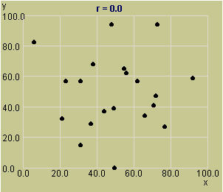
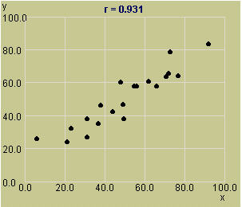
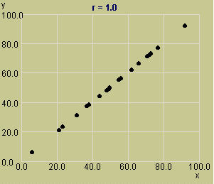
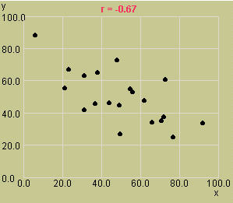
Some Correlation Patterns
r = 0; No correlation
r = .931; Strong positive correlation
r = 1; Linear relationship
r = -.67; Weaker negative correlation

Slide 46
Multivariate Input Models [Multivariate/Time Series]
If X₁ and X₂ are normally distributed, dependence between them can be modeled by the bivariate normal distribution with μ₁, μ₂, σ₁², σ₂² and correlation ρ
To Estimate μ₁, μ₂, σ₁², σ₂², see “Parameter Estimation” (Section 9.3.2)
To Estimate ρ, suppose we have n independent and identically distributed pairs (X₁₁, X₂₁), (X₁₂, X₂₂), … (X_{1n}, X_{2n}), then:
Sample deviation

Slide 47
Covariance and Correlation [Multivariate/Time Series]
A time series is a sequence of random variables X₁, X₂, X₃, … , are identically distributed (same mean and variance) but dependent.
cov(X_{t}, X_{t+h}) is the lag-h autocovariance
corr(X_{t}, X_{t+h}) is the lag-h autocorrelation
If the autocovariance value depends only on h and not on t, the time series is covariance stationary

Slide 48
Summary
In this chapter, we described the 4 steps in developing input data models:
Collecting the raw data
Identifying the underlying statistical distribution
Estimating the parameters
Testing for goodness of fit

